Slide 1

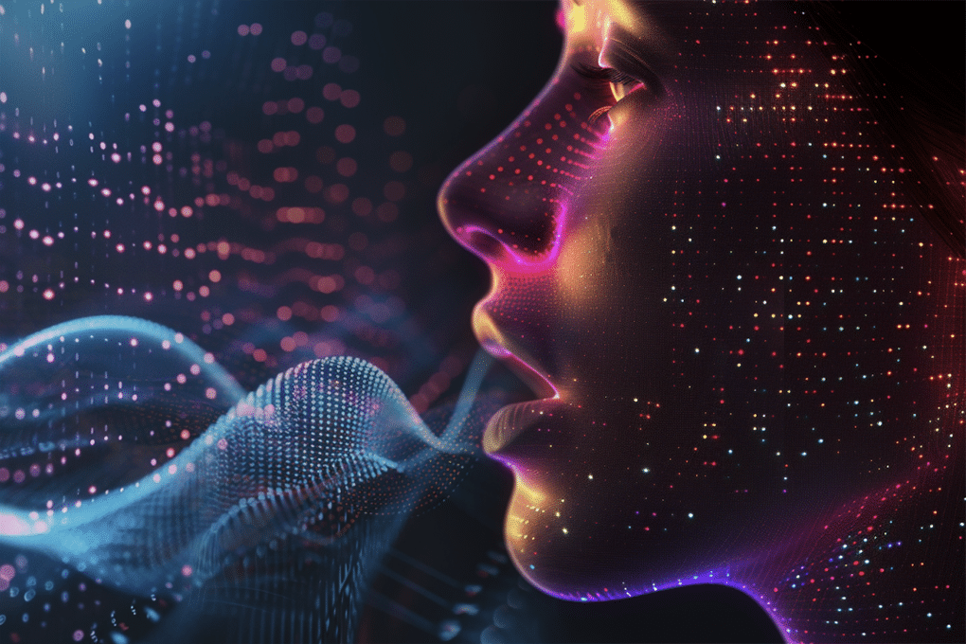
University of Constantine 2 - Abdelhamid Mehri
Faculty of New Technologies
Department of Fundamental Computer Science and its Applications
ASR
Automatic Speech Recognition
by Guebli Ayoub Abdessami,
Master 2 Data science and artificial intelligence

Slide 2
What is Biometric modalities ?
Automatic Speech Recognition (ASR)
Types of Voice Recognition
Sound characteristics
CONTENT
How Voice Recognition Works
Applications of Voice Recognition
Speech Synthesis
Challenges
Conclusion

Slide 3
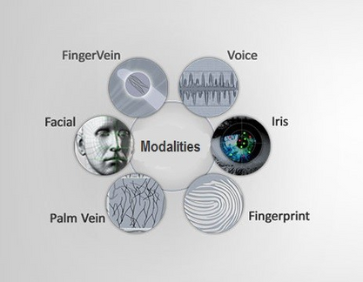
Biometric modalities
Biometric modalities identify individuals using unique physical or behavioral traits, like fingerprints, voice, or facial features. They ensure secure and reliable authentication in various applications, such as security and access control.
what is
Biometric modalities ?
Biometric Features
BIOLOGICAL
MORPHOLOGICAL
BEHAVIORAL
DNA
smell
saliva
urine
hair
veins of the hand
fingerprint
hand geometer
iris
face
palmprint
retina
signator
keystroke dynamics
voice
gait

Slide 4
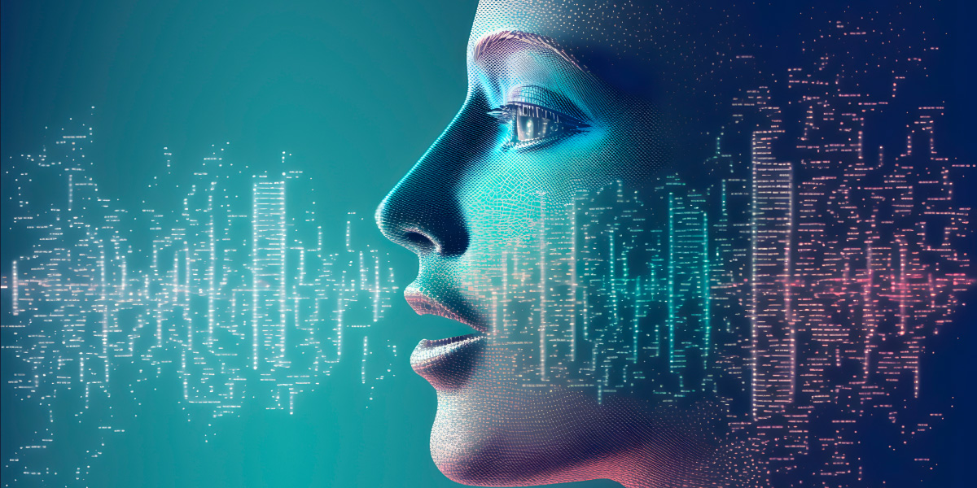
Automatic Speech Recognition
Voice is a unique characteristic used for identification and communication. It is considered a behavioral biometric because it reflects how an individual speaks, influenced by physical traits like vocal cords and behavioral factors like accent and tone. Voice recognition plays a key role in secure systems and user interaction.

Slide 5

speaker recognition | who is talking?
speach recognition | what was said?
language recognition | which language?
emotions recognition | what psychological state?
Types of Voice Recognition

Slide 6
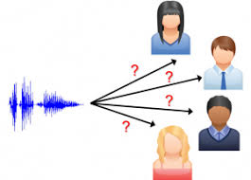
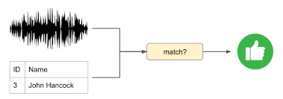
Speaker recognition
Speaker recognition focuses on identifying or verifying a person's identity based on their voice. It can work in two modes:
IDENTIFICATION
Types of Voice Recognition
which determines "Who is speaking?" from a set of voices,
VERIFICATION
which confirms "Is this the correct speaker?" This makes it an essential tool for security and authentication systems

Slide 7
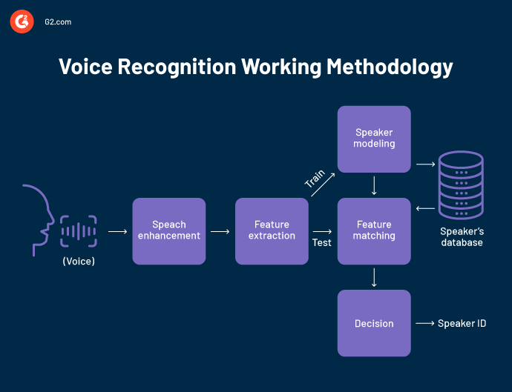
Speaker recognition
Types of Voice Recognition

Slide 8

speach recognition
Speech recognition converts spoken words into text. It supports modes like single speaker, multi-speaker, and speaker-independent systems, enabling human-machine interaction.
RECONNAISSANCE DES MOTS ISOLÉS:
Types of Voice Recognition
Recognizes individual words spoken with pauses between them.
Requires a "listen/not listen" state, where the speaker pauses between words.
Useful for systems where commands or single responses are needed.
RECONNAISSANCE DES MOTS CONNECTÉS:
Processes connected words separated by minimal pauses.
Similar to isolated word recognition but allows smoother transitions between words.
RECONNAISSANCE DE LA PAROLE SPONTANÉE:
Handles natural, spontaneous speech, including hesitations like "um" and "ah."
Adapts to unknown or unpredictable content and variations in natural speech.

Slide 9
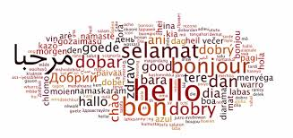

language recognition
Language recognition detects the language spoken by analyzing patterns and sounds. It is vital for multilingual systems and global communication tools.
Types of Voice Recognition
emotions recognition
Emotion recognition identifies emotions like happiness or sadness from voice cues. It improves interactions by making systems more empathetic.

Slide 10
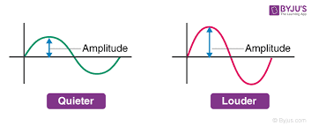
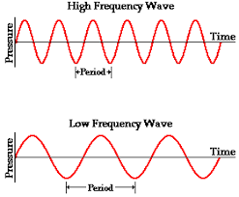
Sound characteristics
AMPLITUDE
FREQUENCY
Amplitude measures the sound's volume, determined by the air pressure variations in a wave. Higher amplitude results in louder sounds, while lower amplitude produces softer sounds.
Frequency is the number of sound wave vibrations per second, measured in Hertz (Hz). Lower frequencies create deeper sounds, while higher frequencies result in sharper, higher-pitched sounds.

Slide 11
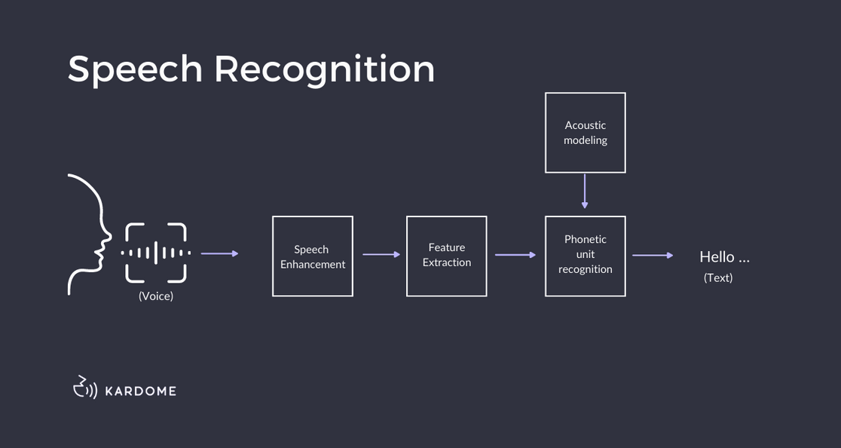
How Voice Recognition Works

Slide 12

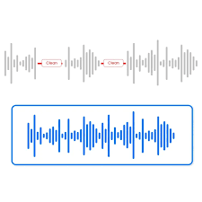
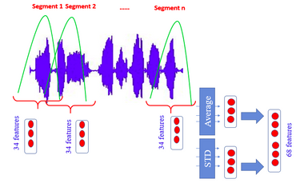
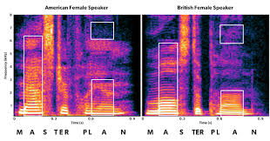
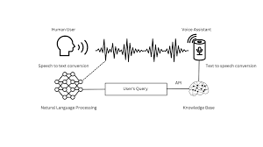
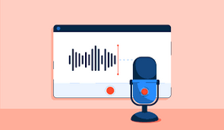
Audio Input | Preproces-sing | Feature Extraction | Matching | Language Process-ing
The process begins with capturing the speaker's voice through a microphone, converting sound waves into a digital audio signal for further analysis. | The audio signal is cleaned by reducing noise, normalizing the volume, and eliminating unnecessary silences, ensuring accurate analysis. | Key acoustic features like pitch, tone, and frequency are extracted from the audio signal. These features are critical for distinguishing between voices and interpreting speech. | The extracted features are compared against stored patterns or models in a database to identify or interpret the speech accurately. | Once the speech is recognized, Natural Language Processing (NLP) algorithms convert it into meaningful text or commands for further actions.

Slide 13
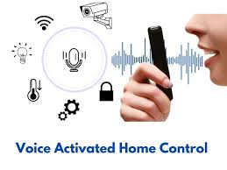
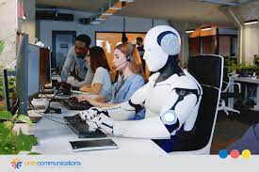


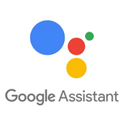
Applications of Voice Recognition
VIRTUAL ASSISTANTS
VOICE-ACTIVATED CONTROLS
CALL CENTER AUTOMATION.
(e.g., Siri, Alexa).
(e.g., smart home devices)

Slide 14
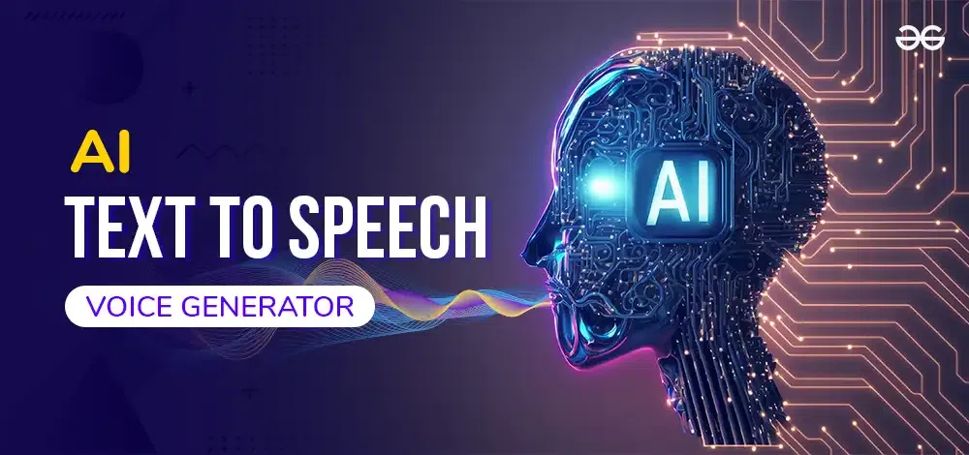
Speech Synthesis
Speech synthesis is a technology that generates artificial speech from text. By combining linguistic processing (to create phonetic representations) and signal processing (to produce sound), it enables applications such as screen readers for the visually impaired and voice-based customer service systems.

Slide 15
BACKGROUND NOISE:
SPEECH VARIABILITY:
Loud or unpredictable sounds can hinder accuracy, requiring advanced noise-cancellation techniques.
Accents, dialects, and speaking speed variations make consistent interpretation difficult, especially in diverse groups.
Challenges in Voice Recognition
PRIVACY CONCERNS:
RESOURCE-INTENSIVE:
Storing and processing voice data raises ethical and legal issues, requiring secure practices and compliance with privacy regulations
Real-time processing demands significant computational power and optimized algorithms.

Slide 16
conclusion
VOICE RECOGNITION TECHNOLOGY IS RAPIDLY ADVANCING, ENHANCING ACCESSIBILITY, AUTOMATION, AND USER INTERACTION ACROSS VARIOUS INDUSTRIES. BY ENABLING MORE INTUITIVE WAYS TO INTERACT WITH DEVICES, IT HAS BECOME INTEGRAL TO VIRTUAL ASSISTANTS, SMART HOME SYSTEMS, AND OTHER APPLICATIONS. HOWEVER, CHALLENGES SUCH AS MANAGING BACKGROUND NOISE, HANDLING SPEECH VARIABILITY, AND ADDRESSING PRIVACY CONCERNS PERSIST. OVERCOMING THESE OBSTACLES REQUIRES CONTINUOUS INNOVATION IN NOISE-CANCELLATION TECHNIQUES, ALGORITHM OPTIMIZATION, AND DATA SECURITY PRACTICES, ENSURING THAT VOICE RECOGNITION CAN REACH ITS FULL POTENTIAL WHILE SAFEGUARDING USER PRIVACY.

